Slide 1
Working with Databases and MySQL

Slide 2
Credits
Some of the contents of this slide presentation have been referenced and reproduced from the textbook for this course, PHP Programming with MySQL (Second Edition) , Don Gosseling, Diana Kokoska, and Robert Easterbrooks, ©2011, Cengage Learning, All Rights Reserved. ISBN 978-0-5387-4584-0.
Thank you for some references to Kevin Skoglund, from PHP with MySQL Essential Training (2013), ©2017 LinkedIn Corporation.

Slide 3
LEARNING OBJECTIVES
Study the basics of databases and MySQL
Work with MySQL databases
Define database tables
Modify user privileges
Work with database records
Work with phpMyAdmin

Slide 4
Introduction to Databases
Introduction
A common use of Web pages is to gather information stored in a database on a server
PHP, and most server-side scripting languages support creation of Web pages that can read and write data to and from databases
MySQL is an open source database
Originally developed by MySQL AB and owned by Sun Microsystems, creators and owners of Java
Both now owned by Oracle Corporation

Slide 5
Introduction to Databases
Introduction
MySQL
Not a part of PHP, although PHP is the language most often associated with it
Just one of many databases PHP can manipulate
Uses SQL, Structured query Language, as its data manipulation language
Used primarily for Web applications
PHP Database Manipulation
Direct manipulation is supported
ODBC: Open Database Connectivity

Slide 6
Introduction to Databases
Database Terminology
A database is an ordered collection of information that a computer program can access
Computer databases store information in tables, similar to spreadsheets
A record in a database is a single complete set of related information
Each column in a database table is called a field
Fields are the individual categories of information stored in a record

Slide 7
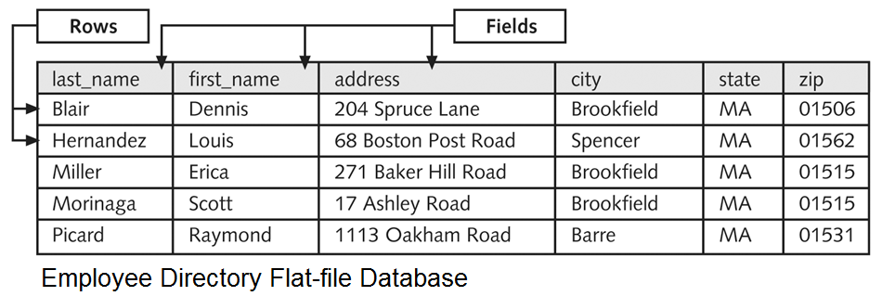
Introduction to Databases
Database Terminology
A flat-file database stores information in a single table
A relational database stores information across multiple related tables

Slide 8
Introduction to Databases
Understanding Table Relationships
Relational databases consist of one or more related tables
A primary table is the main table in a relationship that is referenced by another table
A child table, or related table, references a primary table in a relational database
A primary key is a field that contains a unique identifier for each record in a primary table

Slide 9
Introduction to Databases
Table Relationships are Based on Keys
A primary key is a field in a table, a type of index, which uniquely identifies the records
A foreign key is a field in a related table that refers to the primary key in a primary table
Primary and foreign keys link records into relationships across multiple tables in a relational database

Slide 10
Introduction to Databases
One-to-one Relationship
Exists between two tables when a child table contains exactly one record for each record in the primary table
These relationships are used to break information into multiple, logical sets
Information in the tables in a one-to-one relationship could be placed within a single table
Purposes
Make the information in one of the tables confidential and accessible only by certain individuals

Slide 11
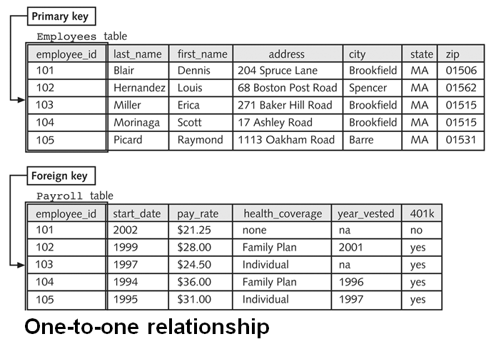
Introduction to Databases
One-to-one Relationship

Slide 12
Introduction to Databases
One-to-many Relationship
Exists between two tables when one record in a primary table has many related records in a child table
Purposes
Breaking tables into multiple related tables to reduce redundant and duplicate information is called normalization
Provides a more efficient and less redundant method of storing this information in a database
Protects against anomalies that can exist in databases

Slide 13
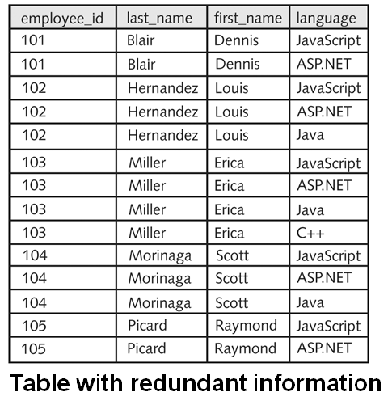
Introduction to Databases
Non-normalized Table

Slide 14
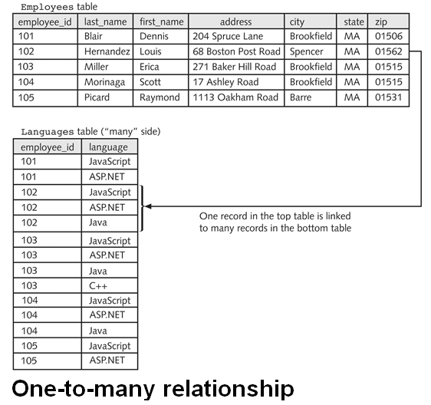
Introduction to Databases
Normalized One-to-many Relationship

Slide 15
Introduction to Databases
Many-to-many Relationship
When many records in one table are related to many records in another table
Not directly supported in relational databases
A junction table is used to form a one-to-many relationship for each of the two tables in a many-to-many relationship
A junction table contains foreign keys from the two tables

Slide 16
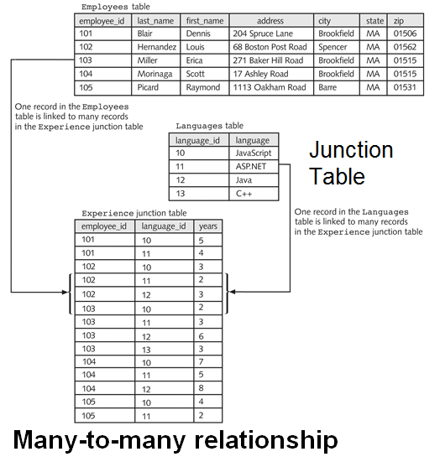
Introduction to Databases
Many-to-many Using Junction Table

Slide 17
Database Management Systems
DBMS Terminology
A DBMS, Database Management System, is an application or collection of applications used to access and manage a database
A schema is the design structure of a database including its tables, fields, and relationships
A flat-file database management system is a system that stores data in a flat-file format
A relational database management system, RDBMS, is a system that stores data in a relational format

Slide 18
Database Management Systems
Important Aspects of a DBMS
The structuring of the database schema
The preservation of the integrity of the database tables
Ensuring that data is validly and correctly stored in a database’s tables, regardless of the database format
Querying capability
Tools for query building, schema design, management, security, access by GUI, and many others

Slide 19
Database Management Systems
Major Concepts of an RDBMS
A query is a structured set of instructions and criteria for retrieving, adding, modifying, and deleting database information
SQL, Structured Query Language, is a standard DML, Data Manipulation Language, used among many database management systems
ODBC, Open Database Connectivity, allows ODBC-compliant applications to access any data source for which there is an ODBC driver

Slide 20
Database Management Systems
Major Concepts of an RDBMS
Every RDBMS is built on the same mathematical principles for database design
Each RDBMS brand is an individual application with differences in data types, storage procedures, additions to the standard SQL syntax, and features
W3C provides much SQL support
A standard language subset
References to different data type implementations based on brand
SQL language differences and additional features

Slide 21
Database Management Systems
Querying a Database with SQL
Developed at IBM in the early 1970s, for Ted Codd’s relational data model
ISO standard developed in 1987, but not completely portable
Based on relational algebra
Includes DML, DDL (Data Definition Language), and DCL (Data Control Language)
Scope includes data insert, query, update and delete, schema creation and modification, and data access control

Slide 22
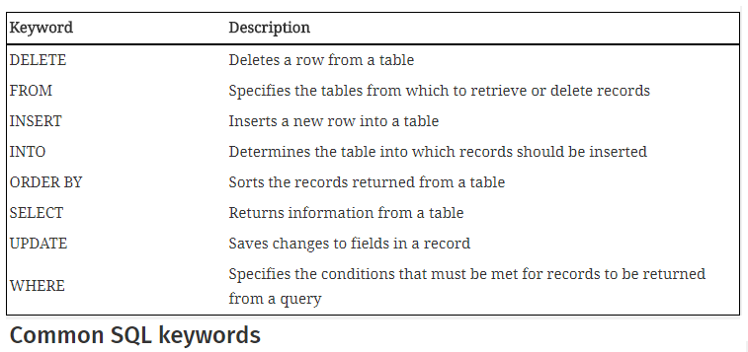
Database Management Systems
Querying a Database with SQL
SQL uses fairly easy-to-understand statements to execute database commands

Slide 23
Database Management Systems
Querying a Database with SQL
Simple SQL statement to return all fields from a table called Employees
SELECT * FROM Employees
More complex SQL that does a more granular query
SELECT lName, fName FROM Employees WHERE city = “Spencer” ORDER BY lName, fName

Slide 24
Work with MySQL Databases
Getting Started with MySQL
MYSQL is a logical fit with Apache and PHP
It supports interfaces with other programming languages: C/C++, Java, and lately, Node.js Javascript
Ways to interface with a MySQL server
MySQL Monitor
phpMyAdmin
MySQL Workbench
PHP API database functions

Slide 25
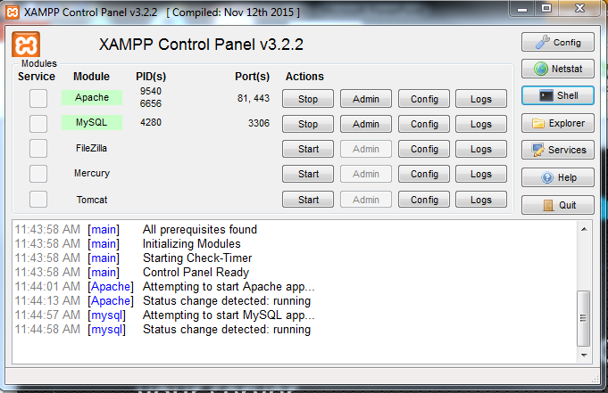
Work with MySQL Databases
MySQL Monitor
Make sure that Apache and MySQL are running on your server

Slide 26
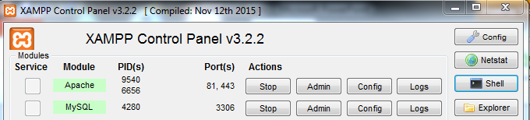
Work with MySQL Databases
MySQL Monitor
MySQL Monitor is a command-line program for manipulating MySQL databases
Connect to the MySQL server using a command-line connect
Commands are entered at the mysql-> command prompt in the console window

Slide 27
Work with MySQL Databases
MySQL Monitor - Login
Login to the MySQL database server from the console mysql –h host –u user –p
host default is localhost
Blank user account allows login without specifying a username or password
user root is the primary administrative account for MySQL: initially created without a password mysql –u root
-p requires a password entry
Logout with the exit or quit commands

Slide 28
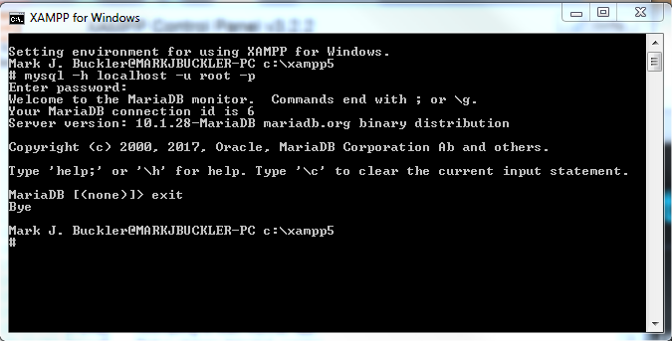
Work with MySQL Databases
MySQL Monitor - Login

Slide 29
Work with MySQL Databases
MySQL Monitor – Entering SQL Commands
MySQL Monitor uses SQL commands
At the mysql> command prompt terminate the command with a semicolon mysql> SELECT * FROM inventory;
Without a semicolon, the MySQL Monitor enters a multiple-line command and changes the prompt to -> mysql> SELECT * FROM inventory ->
The SQL keywords entered in the MySQL Monitor are not case sensitive

Slide 30
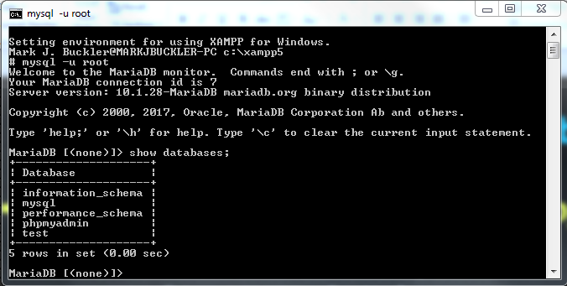
Work with MySQL Databases
MySQL Monitor – Entering SQL Commands
MySQL Monitor SQL example mysql> SHOW databases;

Slide 31
Work with MySQL Databases
Understanding MySQL Identifiers
MySQL requires defined identifiers for databases, tables, fields, indexes, and aliases
An alias is an alternate name used to refer to a table or field in SQL statements
The case sensitivity of database and table identifiers depends on the operating system
Not case sensitive on Windows platforms
Case sensitive on UNIX/Linux systems
MySQL stores each database in a directory of the same name as the database identifier
Field and index identifiers are case insensitive on all platforms

Slide 32
Work with MySQL Databases
Understanding MySQL Identifiers
Identifiers may or may not be used with single quotes
Some require single quotes, or backtick ( ’)
An identifier that includes any character except standard alphanumeric characters, underscores (_) or dollar signs ($)
Any identifier that contains one or more space characters
An identifier that is a reserved word in MySQL
An identifier made entirely of numeric digits
An identifier that contains a backtick character

Slide 33
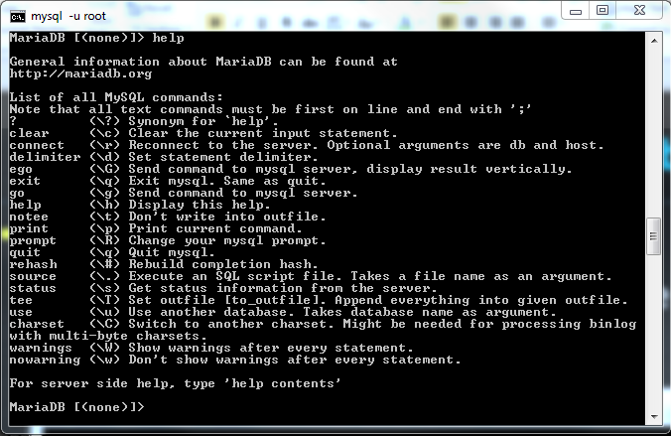
Work with MySQL Databases
MySQL Monitor – Commands
Some MySQL Monitor commands are not SQL mysql> help or mysql> ?

Slide 34
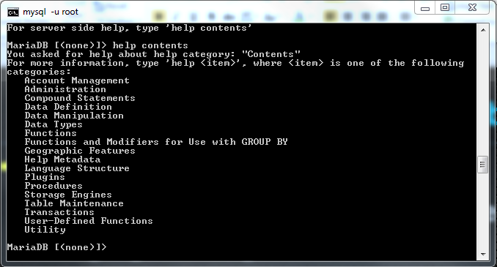
Work with MySQL Databases
MySQL Monitor – Commands
For general help with language and features mysql> help contents

Slide 35
Work with MySQL Databases
Working with MySQL Databases - DDL
Use the CREATE DATABASE statement to create a new database mysql> CREATE DATABASE sitevisitors;
To use a new database, select it by executing the USE DATABASE statement mysql> USE sitevisitors;
Use the SELECT DATABASE()function to return the name of the currently active database mysql> SELECT DATABASE();

Slide 36
Work with MySQL Databases
Working with MySQL Databases
View the available databases using the SHOW DATABASES statement mysql> SHOW DATABASES;
Use the DROP DATABASE statement to remove all tables and delete a database mysql> DROP DATABASE sitevisitors;

Slide 37
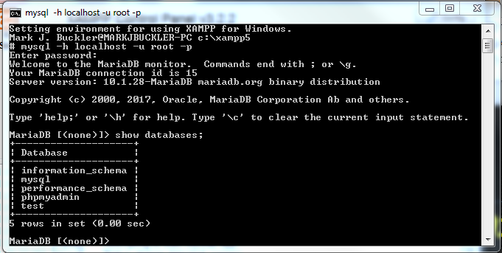
Database Management Systems
Programming Exercise 02_07_01 – Step 1
Working with MySQL Databases

Slide 38
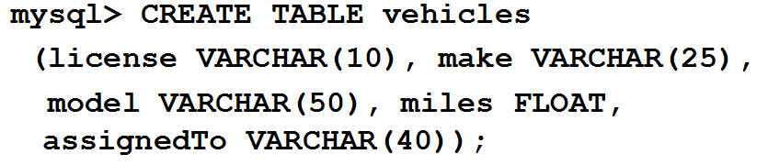
Define Database Tables
Defining and Creating Database Tables - DDL
Data types that are assigned to fields determine how much storage space the computer allocates for the data in the database
Choose the smallest data type possible for each field
Use the CREATE TABLE statement to create a new table and define the column names and data types for each column

Slide 39
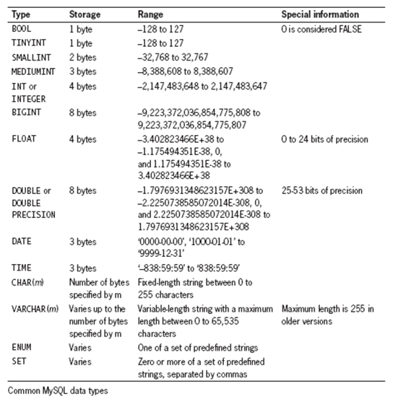
Define Database Tables
Defining and Creating Database Tables

Slide 40
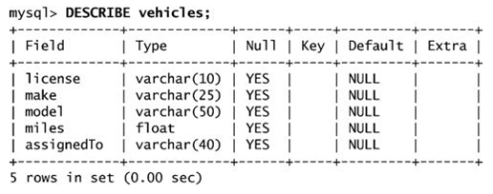
Define Database Tables
Viewing Table Structure
Use the DESCRIBE tableName statement to view the structure of the table mysql> DESCRIBE vehicles;

Slide 41
Define Database Tables
Programming Exercise 02_07_01 – Step 2
Defining and Creating Database Tables

Slide 42

Define Database Tables
Altering Tables - DDL
Use the ALTER TABLE statement to modify the structure of a table
To add a new column, and pick its data type, employ the ADD COLUMN syntax
To change the data type of an existing column, employ the MODIFY COLUMN syntax

Slide 43


Define Database Tables
Altering Tables - DDL
Use the ALTER TABLE statement to modify the structure of a table
To rename a column, employ the CHANGE COLUMN syntax
To rename an existing table, employ the RENAME TO syntax

Slide 44

Define Database Tables
Altering Tables - DDL
Use the ALTER TABLE statement to modify the structure of a table
To remove a column, employ the DROP COLUMN syntax
To delete an existing table, employ the DROP TABLE syntax

Slide 45
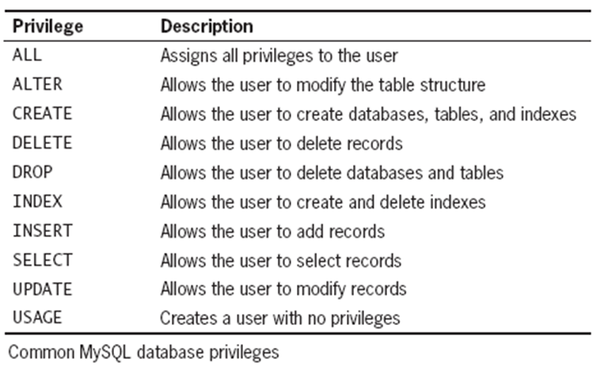
Modifying User Privileges
Granting and Revoking Privileges - DCL
Privileges are actions and operations a user can perform with a table or a database
User accounts should only be assigned the minimum necessary privileges to perform given tasks

Slide 46
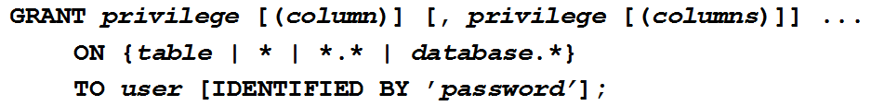
Modifying User Privileges
Granting Privileges - DCL
The GRANT statement creates the user account if it does not exist and assigns the specified privileges
If the user account already exists, the GRANT statement just updates the privileges

Slide 47
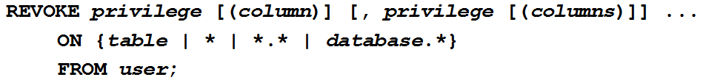
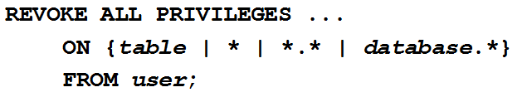
Modifying User Privileges
Revoking Privileges - DCL
The REVOKE ALL PRIVILEGES statement removes all privileges from a user account for a specified table or database
You must be logged in with the root account or have sufficient privileges to revoke privileges from another user account

Slide 48
Work with Database Records
Adding Records - DML
Use the INSERT INTO statement to add individual records to a table
The values entered in the VALUES list must be in the same order in which you defined the table fields
Specify NULL in any fields for which you do not have a value

Slide 49
Work with Database Records
Programming Exercise 02_07_01 – Step 3
Adding Records

Slide 50

Work with Database Records
Adding Records from a Text File- DML
Use the LOAD DATA statement to add multiple records to a table from a local text file
Each record in the text file must be placed on a separate line with a tab delimiter between each field

Slide 51

Work with Database Records
Adding Records from a Text File- DML
If the column list is omitted, the values on each line must be in the same order as the defined table fields
Use consecutive tabs with nothing between them to designate a column with no value

Slide 52
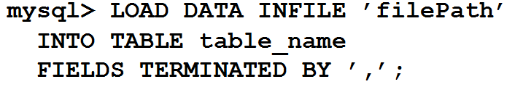
Work with Database Records
Adding Records from a Text File - DML
The optional FIELDS TERMINATED BY clause of the LOAD DATA statement enables changing the field delimiter to another character such as (~ or ,) instead of the default tab character
Use consecutive delimiters with nothing between them to designate a column with no value

Slide 53
Work with Database Records
Programming Exercise 02_07_01 – Step 4
Adding Records from a Text File

Slide 54

Work with Database Records
Retrieving Records - DML
Use the SELECT statement to retrieve records from a table SELECT criteria FROM tableName;
Use the asterisk ( * ) wildcard with the SELECT statement to retrieve all fields from a table
To return multiple fields, separate field names with a comma

Slide 55
Work with Database Records
Programming Exercise 02_07_01 – Step 5
Retrieving Records from a Table

Slide 56
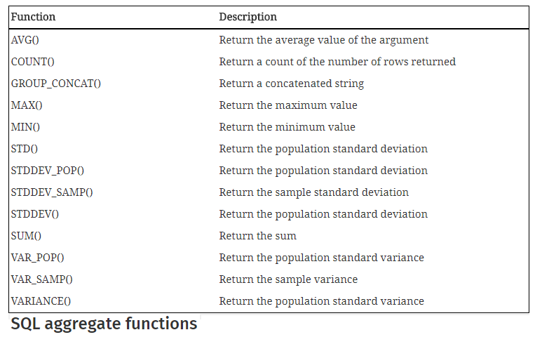
Work with Database Records
Using Aggregate Functions - DML
Aggregate functions summarize data in record sets rather than display the individual records

Slide 57
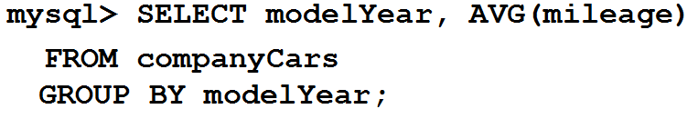
Work with Database Records
Using Aggregate Functions - DML
There are two ways to use aggregate functions
If they are used in the SELECT, with or without a WHERE clause, the results include all records
To retrieve aggregate values for groups of records, use the GROUP BY clause and include the fields that you use to group the records as part of the query

Slide 58
Work with Database Records
Using Aggregate Functions - DML
The COUNT()function is unique in that
The wildcard ( * ) can be used as a function argument instead of a field name
The keyword DISTINCT can be used after the opening parentheses SELECT COUNT(DISTINCT Country) FROM Customers;
With DISTINCT, each unique value is counted as 1, no matter how many records contain it
DISTINCT can also be used with the SELECT statement to retrieve records with a unique value in the WHERE clause SELECT DISTINCT Country FROM Customers;

Slide 59
Work with Database Records
Programming Exercise 02_07_01 – Step 6
Using Aggregate Functions

Slide 60

Work with Database Records
Sorting Query Results - DML
Use the ORDER BY keyword with the SELECT statement to perform an alphanumeric sort of the query results
To perform a reverse sort, add the DESC keyword after the name of the field

Slide 61
Work with Database Records
Programming Exercise 02_07_01 – Step 7
Sorting Query Results

Slide 62

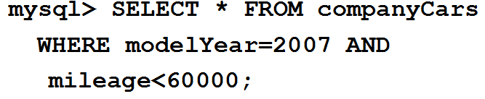
Work with Database Records
Filtering Query Results - DML
The criteria portion of the SELECT statement determines which fields to retrieve from a table
You can also specify which records to return by using the WHERE keyword
Use the keywords AND and OR to specify more detailed conditions about the records to return

Slide 63
Work with Database Records
Programming Exercise 02_07_01 – Step 8
Filtering Query Results

Slide 64
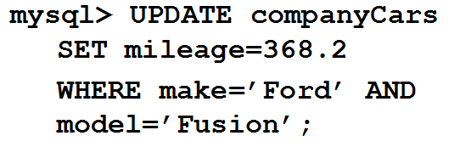
Work with Database Records
Updating Records - DML
To update records in a table, use the UPDATE statement and specify the name of the table to update
The SET keyword specifies the value to assign to the fields in the records that match the condition in the WHERE keyword

Slide 65
Work with Database Records
Programming Exercise 02_07_01 – Step 9
Updating Records

Slide 66
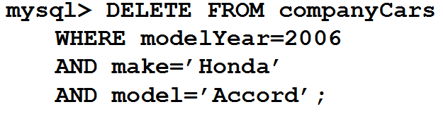
Work with Database Records
Deleting Records - DML
The DELETE statement deletes all records that match the condition
To delete all the records in a table, leave off the WHERE keyword

Slide 67
Work with Database Records
Programming Exercise 02_07_01 – Step 10
Deleting Records

Slide 68
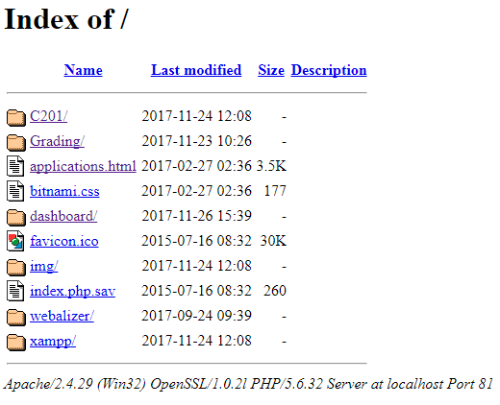
Working with phpMyAdmin
phpMyAdmin
A GUI, written in PHP, shipped with XAMPP used to handle the administration of MySQL databases
Can perform all of the tasks that we have done using the Console of MySQL Monitor

Slide 69
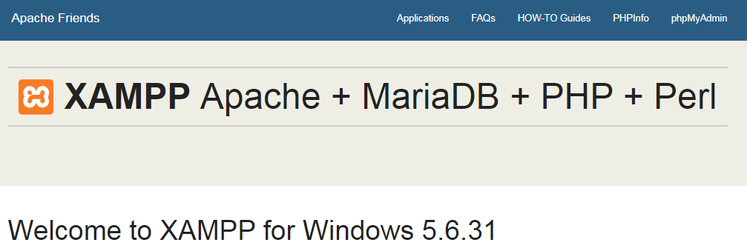
Working with phpMyAdmin
phpMyAdmin

Slide 70
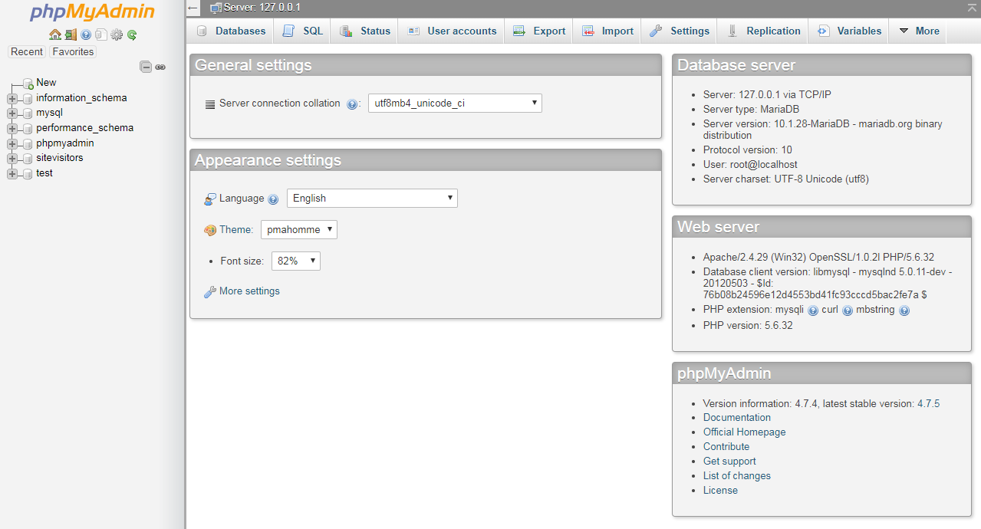
Working with phpMyAdmin
phpMyAdmin

